Slide 1

Design & Simulation of a Digital Error Detection System Using Parity
A comprehensive logic design study on parity generation, transmission error checking, and XOR-based verification using Logisim.
Likhita 2620030468
Dheeraj 2620030472
Rupesh 2620030517
Druveen 2620030528
SUBMITTED BY
DEPARTMENT & INSTITUTION
Dept. of Computer Science & Eng.
Academic Year 2026
Digital Design & Computer Architecture
Slide 1 of 12

Slide 2


Abstract & Overview
Digital Data Integrity: High-speed data transmission across physical communication channels is highly susceptible to noise, attenuation, and electromagnetic interference.
Parity Error Detection: Parity bit generation is a standard, lightweight method used to identify single-bit flips by maintaining odd or even logic states.
Implementation Objective: Design a robust combinational circuit using cascaded XOR gates to compute parity at transmission and verify consistency at reception.
Logisim Validation: Practical schematic modeling and interactive switch simulation to verify real-time error detection flags.
Design & Simulation of Error Detection System
Slide 2 of 12

Slide 3


Introduction to Error Detection
Communication Noise
Redundant Bit Concept
During digital transmission, transient pulses or signal crosstalk can alter binary bits (0 to 1 or 1 to 0). Without error detection, corrupt commands or corrupted memory streams degrade system reliability.
Error detection appends extra redundant bits to the payload. These extra bits carry zero user data but enable the receiver's combinational logic to validate message authenticity.
Digital Communication Principles
Slide 3 of 12

Slide 4




Problem Statement & Channel Noise
The Technical Challenge
Visual Data Comparison
As microprocessors push to higher clock frequencies, transmission line noise increases. Software-based error checking introduces unacceptable CPU overhead.
TRANSMITTED PAYLOAD
1 0 1 0 [P=0]
Even Parity: Total 1s = 2 (Even State)
Manual or delayed software verification causes system latency.
Hardware must evaluate bit integrity in nanoseconds.
CORRUPTED RECEIVED PAYLOAD
1 1 1 0 [P=0]
Need for a minimal gate-count combinational error detector.
Single Bit Flip: Total 1s = 3 (Odd State) → ERROR DETECTED!
Hardware Error Detection Requirements
Slide 4 of 12

Slide 5











Project Objectives & Scope
Circuit Architecture
Even / Odd Parity Logic
Single-Bit Detection
Design a 4-bit data stream parity generator and receiver checker circuit using optimized logic gates.
Formulate and implement Boolean parity logic equations based on XOR/XNOR gate cascade structures.
Ensure reliable detection of single-bit transmission corruption before data reaches memory buses.
Logisim Simulation
Test Vector Analysis
Academic Foundation
Construct the complete digital system schematic in Logisim software to simulate operational conditions.
Verify system logic across all $2^n$ binary input combinations to demonstrate total reliability.
Establish practical insights into error detection protocols vital for DDCA hardware coursework.
Core Project Targets
Slide 5 of 12

Slide 6
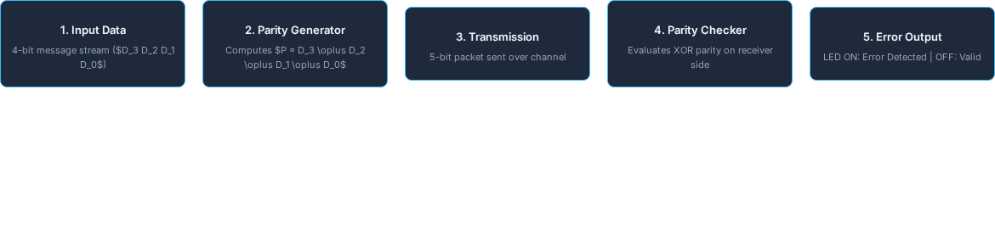

System Methodology & Workflow
Stage Highlights
The input stream undergoes parity calculation in the generator block before transmission. At the receiving terminal, the 5-bit bundle enters an identical XOR network. Any discrepancy between computed and received parity trips the error output state.
Methodology & Modular Design
Slide 6 of 12

Slide 7

Working Principle & XOR Logic
XOR Gate Foundation
The Exclusive-OR (XOR) gate serves as a modulo-2 adder. It produces a HIGH (1) output if and only if the number of HIGH inputs is odd.
Input A | Input B | Output (A ⊕ B) | Parity State
0 | 0 | 0 | Even (0 ones)
0 | 1 | 1 | Odd (1 one)
1 | 0 | 1 | Odd (1 one)
1 | 1 | 0 | Even (2 ones)
Even Parity Bit Equation:
Even Parity: Parity bit $P$ is chosen to make total count of 1s in $(Data + P)$ even.
Odd Parity: Parity bit $P$ is chosen to make total count of 1s in $(Data + P)$ odd.
Boolean Logic Operations
Slide 7 of 12

Slide 8

Hardware Circuit Architecture
Logic Subsystems
4-Bit Input Line: Connects data switches ($D_3, D_2, D_1, D_0$) directly to the generator block.
Parity Generator: Cascaded 2-input XOR gates (IC 7486) synthesize parity bit $P$.
Transmission Bus: Transmits 5 parallel lines ($D_3, D_2, D_1, D_0, P$) to the receiver.
Parity Checker: A 5-input XOR tree calculates total modulo-2 parity state $E$.
Error Indicator: Output $E = 0$ keeps LED OFF (Valid Data); $E = 1$ triggers LED ON (Corruption).
Hardware Schematic Topology
Slide 8 of 12

Slide 9
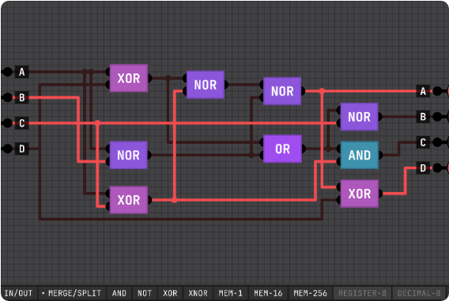


Logisim Simulation Environment
Simulation Features
Interactive Pin Switches: Toggle bits dynamically to simulate live data input.
Fault Injection: Noise buttons simulate transmission bit flips along channel wires.
Visual Status Indicators: Probe components display logic levels ($0/1$) at intermediate XOR nodes.
LED Output Probe: Instantly alerts user upon parity mismatch.
LED OFF (0)
LED ON (1)
No Transmission Errors
Single-Bit Error Detected
Logisim Simulation Verification
Slide 9 of 12

Slide 10
Simulation Results & Verification
Input Data ($D_3 D_2 D_1 D_0$) | Generated Parity ($P$) | Transmitted Packet | Received Packet | Error Output ($E$) | Status
1 0 1 0 | 0 | 1 0 1 0 0 | 1 0 1 0 0 (Unchanged) | 0
1 1 0 0 | 0 | 1 1 0 0 0 | 1 1 0 0 0 (Unchanged) | 0
1 0 1 0 | 0 | 1 0 1 0 0 | 1 0 0 0 0 (Bit Flip) | 1
1 1 1 0 | 1 | 1 1 1 0 1 | 0 1 1 0 1 (MSB Flip) | 1
Verification Summary: The Logisim model successfully verified all $2^4 = 16$ test vectors. In all single-bit error scenarios, the receiver output line $E$ switched HIGH instantly, validating the combinational circuit design.
Experimental Truth Table Verification
Slide 10 of 12

Slide 11



Advantages, Limitations & Uses
Key Advantages
Limitations
Practical Uses
Minimal hardware complexity (uses standard IC 7486 XOR gates).
Detects only single-bit or odd numbers of bit errors.
Serial protocols (UART / RS-232 communication).
Extremely low propagation delay and high processing speed.
Cannot locate exact corrupt bit position.
Computer memory subsystems (Parity RAM / L1 Cache).
Zero computational overhead on system processor.
Cannot perform error correction (requires retransmission).
Bus transmissions in Embedded Microcontrollers.
Trade-Offs & Application Domains
Slide 11 of 12

Slide 12


Conclusion & Future Scope
Conclusion
Future Enhancements
Parity generation provides a fast, economical solution for single-bit transmission error detection.
Hamming Code Integration: Expand to 7-bit Hamming code for single-bit error correction.
Cascaded XOR gate networks implement parity generation and checking with minimal gate count.
Cyclic Redundancy Check (CRC): Implement polynomial division for multi-bit burst error checking.
Logisim simulation proved $100\%$ detection accuracy for single-bit faults across test vectors.
FPGA / Hardware Prototype: Synthesize the design onto a Xilinx/Intel FPGA board.
Thank You!
DDCA Academic Project Presentation
Slide 12 of 12

